Slide 1
Graphing Categorical Data
Chapter 2

Slide 2
The Three Rules of Data Analysis
Make a picture—things may be revealed that are not obvious in the raw data. These will be things to think about.
Make a picture—important features of and patterns in the data will show up. You may also see things that you did not expect.
Make a picture—the best way to tell others about your data is with a well-chosen picture.

Slide 3
Two Types of Graphs for Categorial Data
Bar Graphs (Charts)
Pie Graphs (Charts)

Slide 4
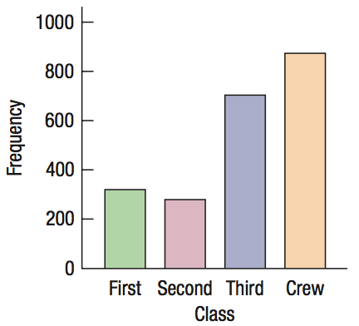
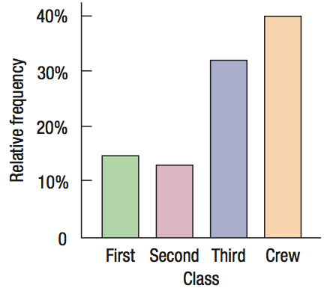
Bar Graphs
Frequency Bar Graph
Relative Frequency Bar Graph
Displays the counts for each category
Displays the proportion of counts
Notice they are the same graph except the vertical axis

Slide 5
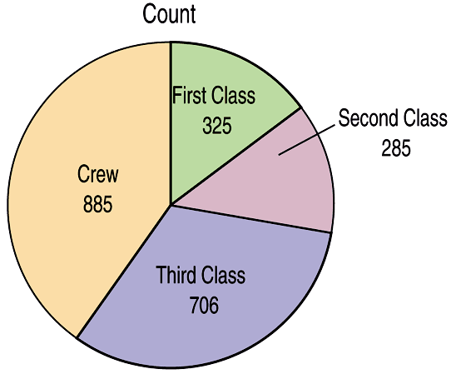
Pie Graphs
When you are interested in parts of the whole, a pie chart might be your display of choice.
Pie charts show the whole group of cases as a circle.
They slice the circle into pieces whose size is proportional to the fraction of the whole in each category.
They can be displayed as a frequency pie chart (counts) or a relative frequency pie chart (%).

Slide 6
Think before you draw!
Our first rule of data analysis is make a picture. But what kind of picture?
Knowing when to use each type of graph is a critical first step in data analysis.
That decision depends in part on what type of data we have.
It’s important to check that the data are appropriate for whatever method of analysis you choose.
Before you make a bar chart or a pie chart, always check the categorical data condition: the data are counts or percentages of individuals in non-overlapping categories.

Slide 7
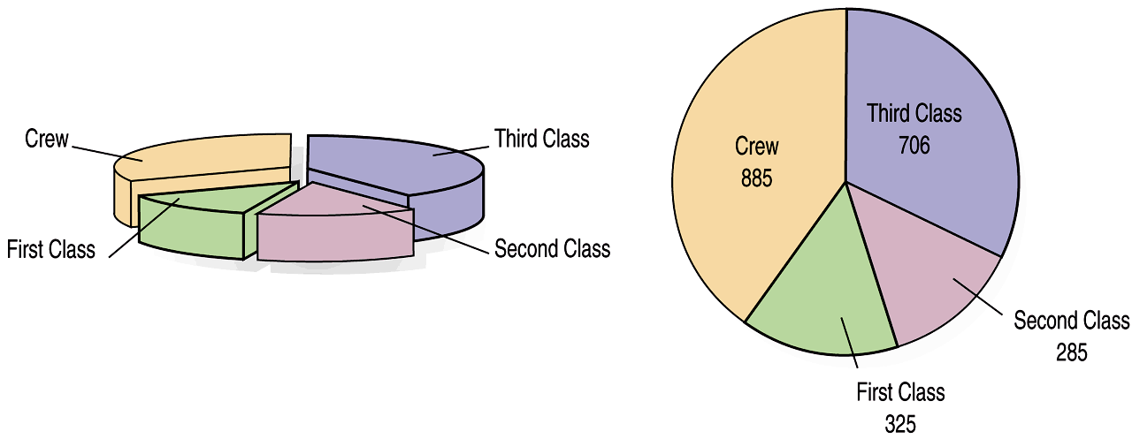
Don’t violate the Area Principal
While some people might like the pie chart on the left better, it is harder to compare fractions of the whole, which a flat pie chart does easily.

Slide 8
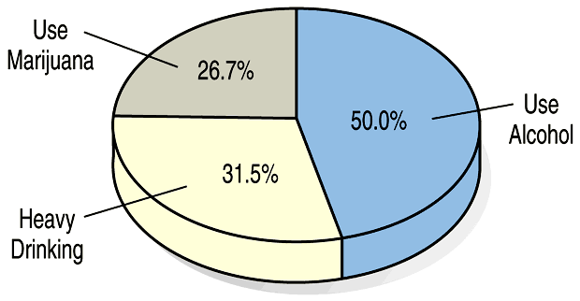
Keep it honest
This plot of the percentage of high-school students who engage in specified dangerous behaviors has a problem. Can you see it?
It doesn’t add to 100% because of the overlapping categories
The Area Principal is violated because the blue section looks less than half

Slide 9
Requirements of a Graph
Title your graph. Hint: This is the most missed item on the first test!
Labeled each axis of a bar graph.
Label each sector of a pie graph.
Label and use appropriate scale.
Obey the Area Principal.
The widths of each category in a bar graph are equal.
The heights in a bar graph should match the scale of the data.
All sections in a pie graph should total 100%.
Each section in a pie graph should match the scale of the data.

Slide 10
Homework Week 1
Log into Canvas Course
Read syllabus
Connect to MyLab & Mastering (Pearson) following directions from syllabus
Complete HW Chapter 1
Read Chapter 2 PP
Complete HW Chapter 2
Bring your graphing calculator to class!

